Slide 1
Feature Engineering & EDA Assignment
Industry Case - Credit card Transaction Data
Varadharajan Suresh
vs2769

Slide 2
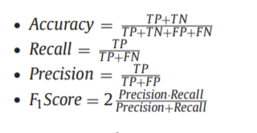
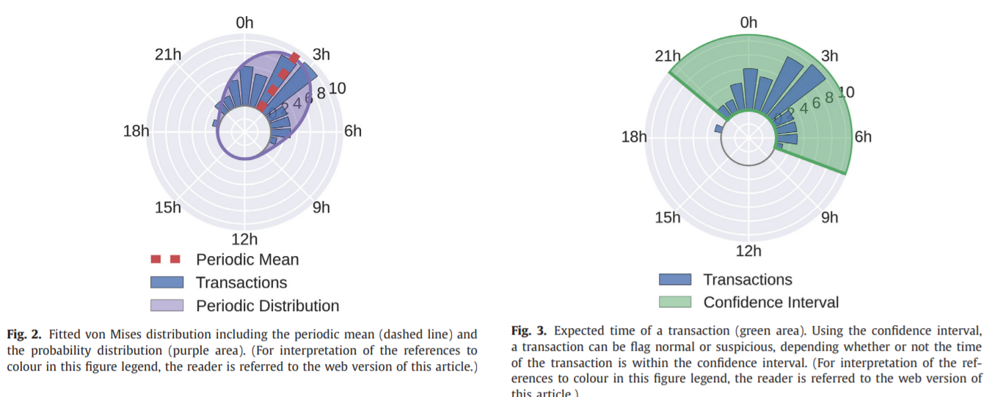
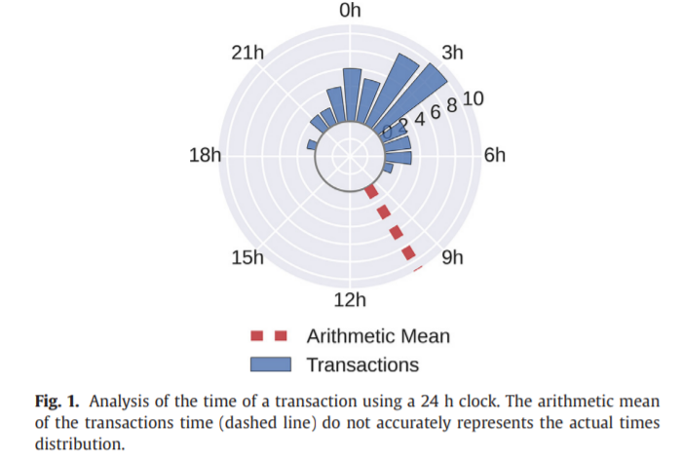
Feature engineering strategies for credit card fraud detection
Introduction
Credit card fraud detection evaluation
Feature engineering for fraud detection
Capturing customer spending patterns
Time features

Slide 3
Feature engineering strategies for credit card fraud detection
Experimental setup
Database:The total dataset contains 120,000,000 individual transactions, each one with 27 attributes. 40,000 transactions were labeled as fraud, leading to a fraud ratio of 0.025%.
Database partitioning: training, validation and testing. Each one containing 50%, 25% and 25%
Algorithms
three cost-insensitive classification algorithms: decision tree (DT), logistic regression (LR) and a random forest (RF);
Bayes minimum risk (BMR) was also used.
Cost-sensitive logistic regression algorithm, cost-sensitive decision tree algorithm

Slide 4
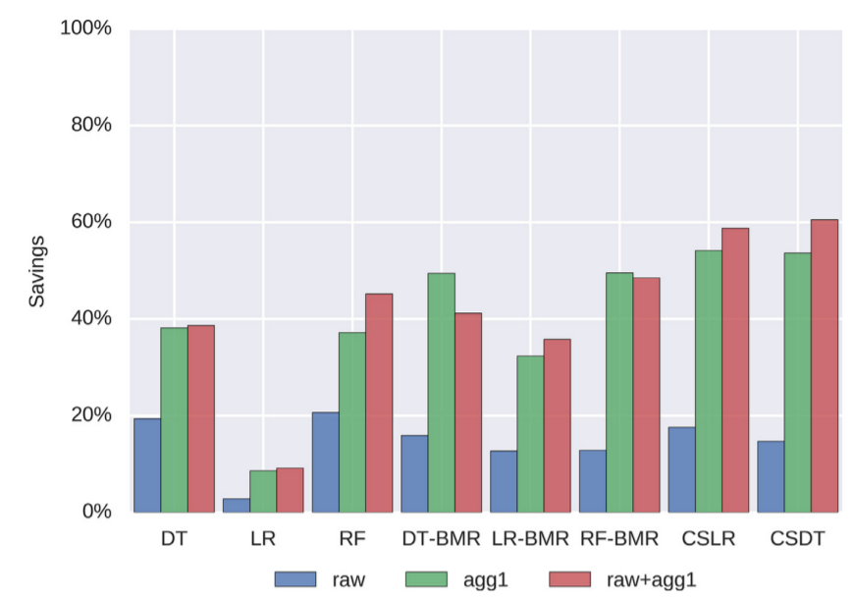
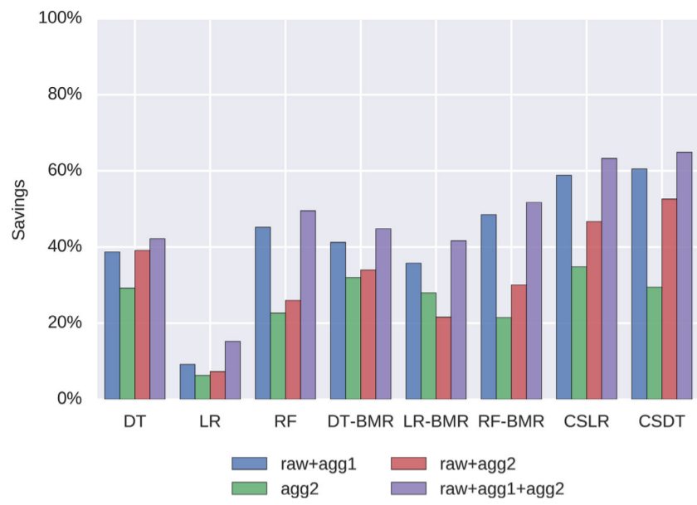
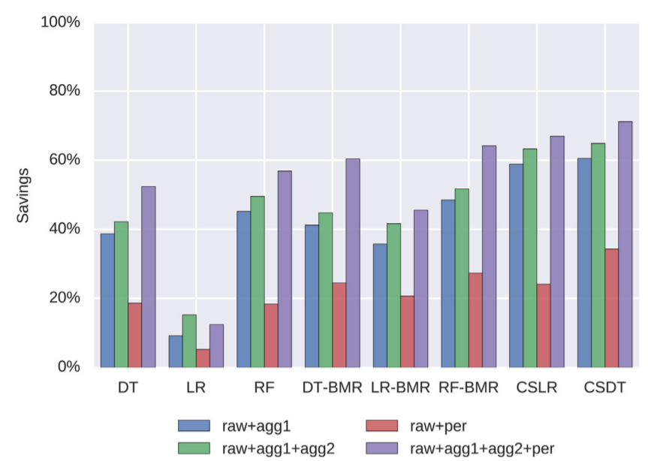
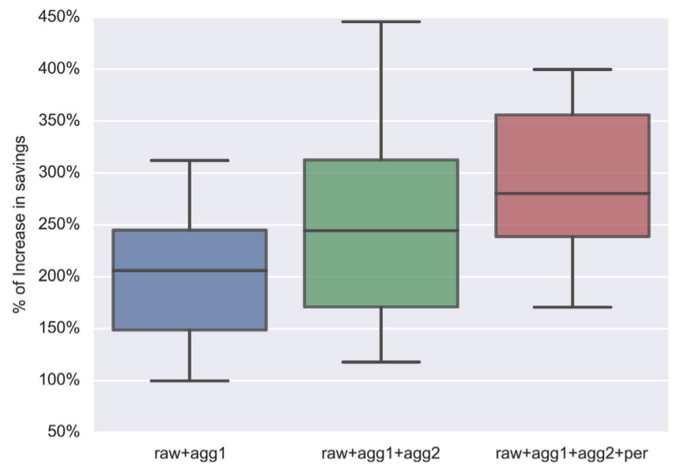
Feature engineering strategies for credit card fraud detection
Results

Slide 5
Part – 2

Slide 6
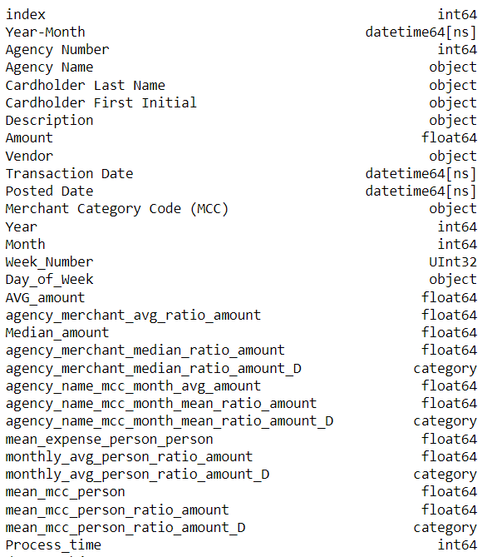
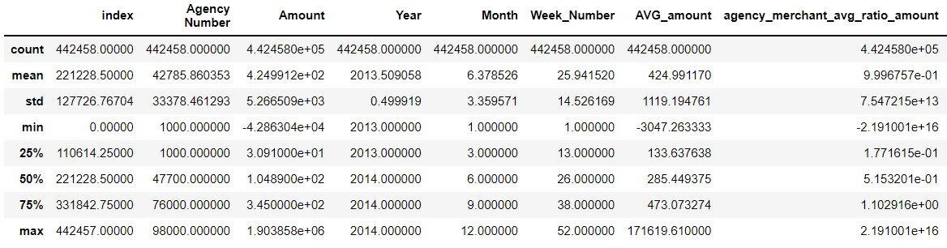
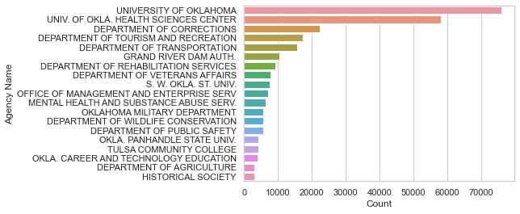
Introduction to Data

Slide 7
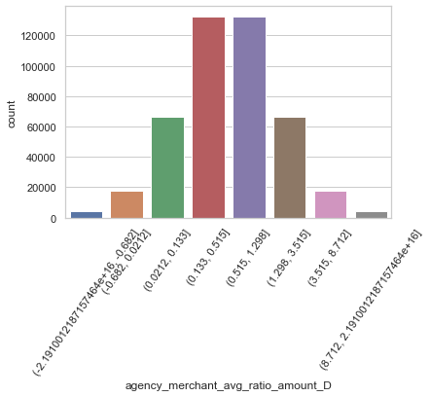
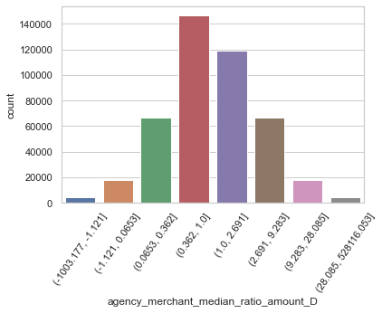
Feature engineering: Features 1 & 2
Grouping by agency, MCC we calculate the median amount spent. This helps understand the median expenditure for a person in an agency per merchant category.
Grouping by agency, MCC we calculate the average amount spent. This helps understand the mean expenditure for a person in an agency per merchant category.

Slide 8
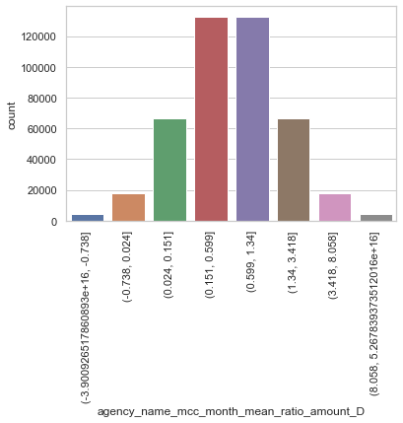

Feature engineering: Features 3 & 4
Grouping by agency, MCC and Month we calculate the average amount spent. This helps understand the monthly expenditure for a person in an agency per merchant category.
Grouping by Year, Month and Person we calculate the average amount spent. This helps understand the average monthly expenditure in year per person

Slide 9
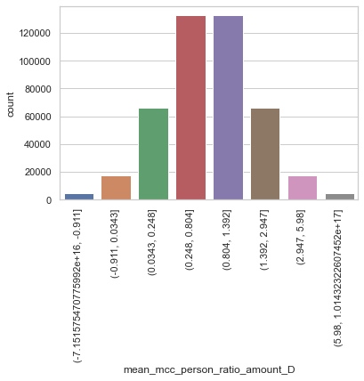
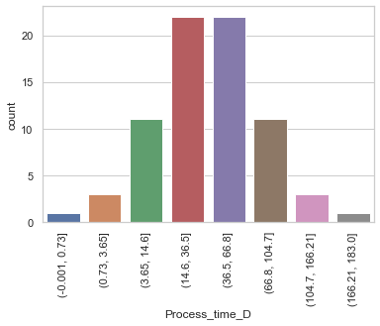
Feature engineering: Features 5 & 6
Posted Time – Transaction Time
Grouping by Cardholder Last Name and merchant category code and obtaining the average amount spent by a person in a merchant category.

